Slide 1
Innovations Shaping the Future
International Tech Summit 2028
26th Ordinary Session of the ATU Board of Directors
Location : KING FAHD PALACE HOTEL
Dakar - SENEGAL
Dates: May 28-30, 2025
1

Slide 2
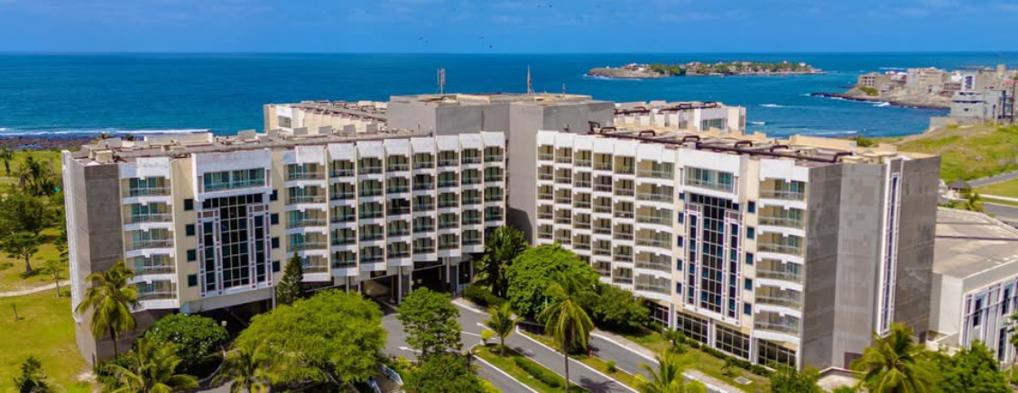
KING FAHD
HOTEL
Event site
Address : Route des Almadies, B.P : 8181 Dakar- Sénégal
Phone: +221 33 869 69 69. Fax : +221 33 869 69 24 ;
Email. Reservation.dakar@kingfahdpalacehotels.com
website : https://www.kingfahdpalacehotels.com
2

Slide 3
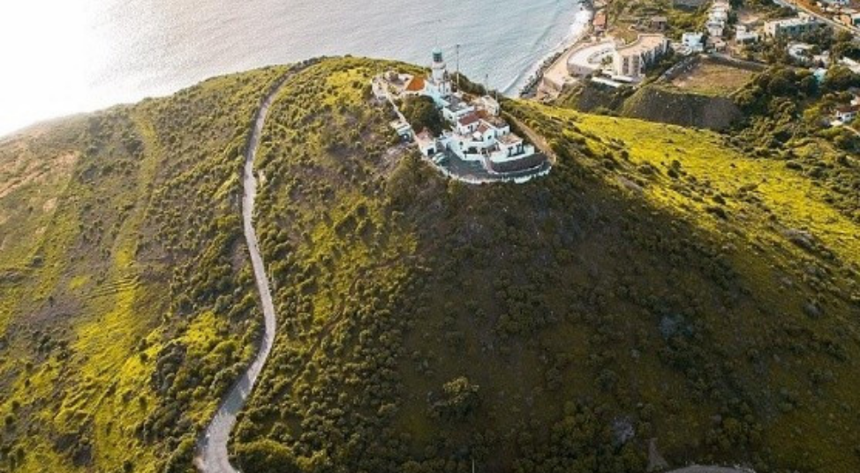
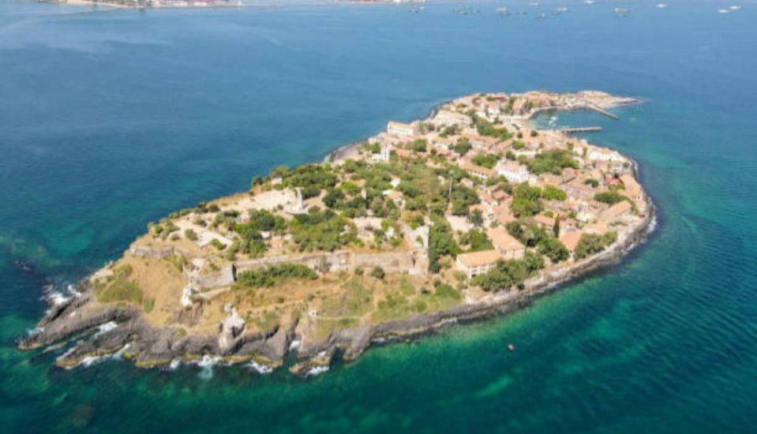
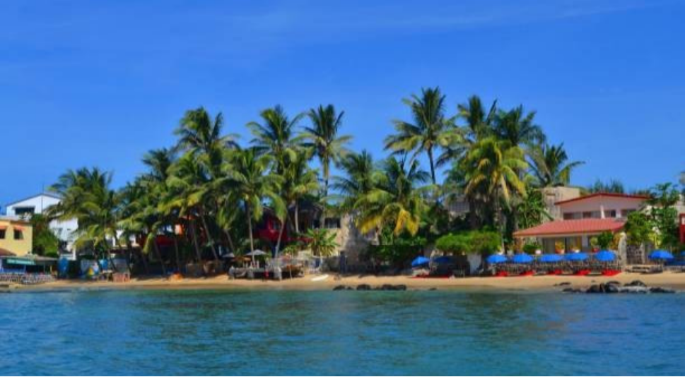
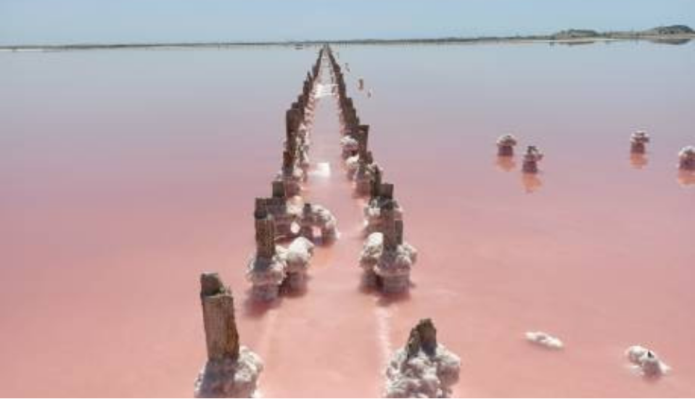
Senegal lies at the westernmost tip of the African continent in the Atlantic Ocean, at the confluence of Europe, Africa and the Americas, and at the crossroads of major sea and air routes. Between 12° and 17° north latitude and 11° C and 18°C west longitude, Senegal is bordered to the north and northeast by Mauritania, to the southeast by Mali, and to the south by Guinea and Guinea Bissau. The Gambia forms a 10,300 km² enclave within Senegalese territory.It has a population of 18,126,390 (source ANSD).Senegal's strategic geographical position means it is open to the world and easily accessible.Translated with DeepL.com (free version)
phare des mamelles
ile de Gorée
ile de Ngor
Lac Rose
3

Slide 4
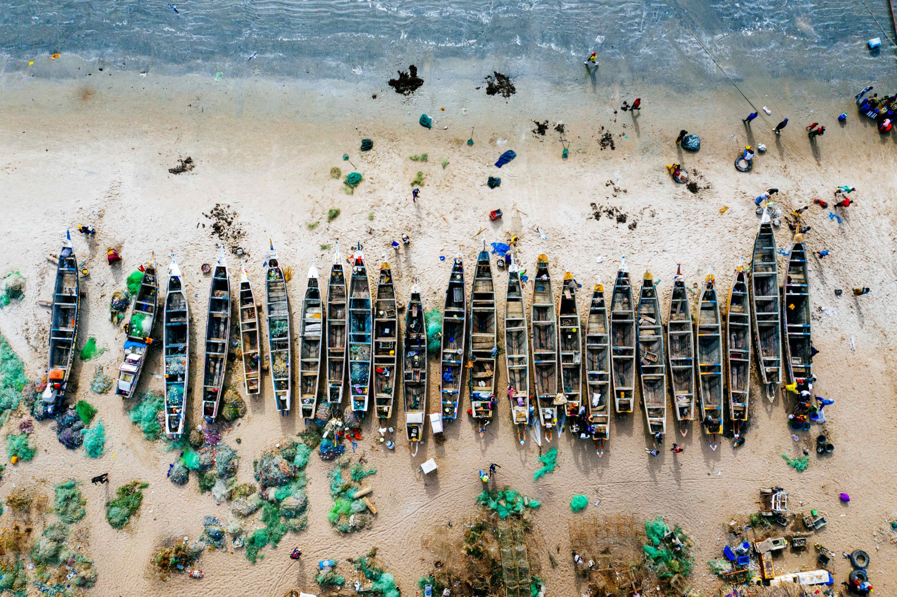
CONTACTS FOR ANY ASSISTANCE
VISAS REQUIREMENTS
All travelers arriving in Senegal should have a valid passport. Nationals of ECOWAS states and certain other countries are not required to present an entry visa. Participants are therefore advised to check whether or not they are exempt from visa requirements at their respective Senegalese embassies. Participants from other countries who have Senegalese embassies in their country must apply for a visa in advance, to be issued on presentation of documents. Under Senegal's visa policy in force on April 8, 2025, citizens of many African countries do not require a visa for a stay of less than 90 days.Translated with DeepL.com (free version)
Name: Mamadou GUEYE, Chief Protocole
Phone number: +221 77 637 03 65
email : mamadou.gueye@artp.sn
Name : M. Alioune DIAKHATE
Phone number : +221 77 549 66 08
Email : alioune.diakhate@artp.sn
4

Slide 5
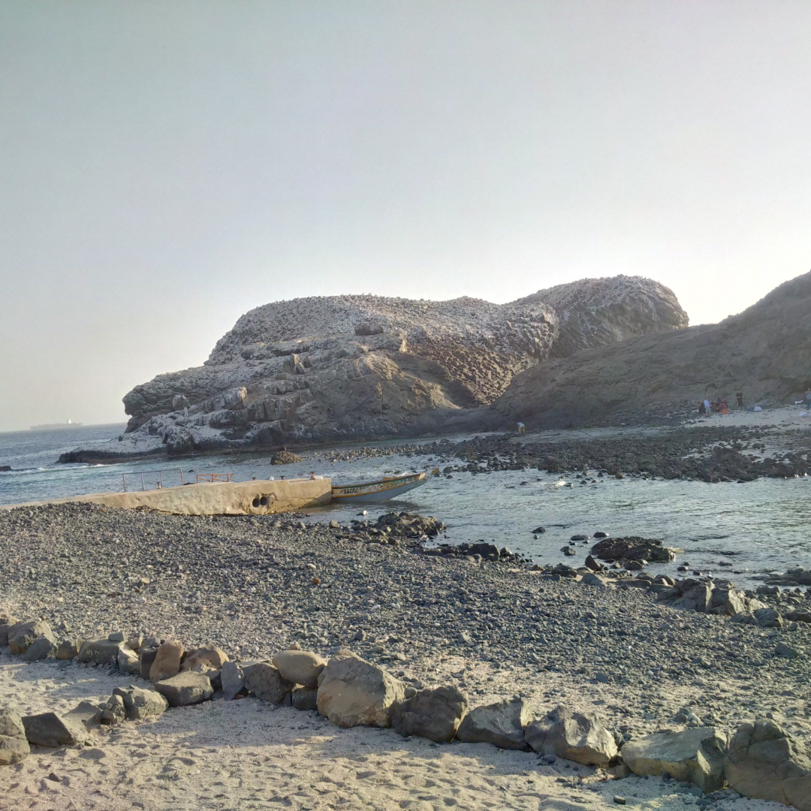
LISTE DES PAYS N'AYANT PAS BESOIN DE VISA
LIST OF COUNTRIES REQUIRING A VISA
Mauritius (except for valid passports),
Mozambique,
Namibia,
Uganda (except for diplomatic and service passports),
Democratic Republic of Congo,
Somalia,
Sudan,
South Sudan,
Tanzania,
Zambia,
Zimbabwe.
It is crucial to stress once again that this list is not exhaustive, and that visa policies may change at any time.
Algeria (except for diplomatic and service passports) ,
Angola,
Botswana,
Burundi,
Cameroon (except for valid passports),
Comoros,
Egypt,
Eritrea,
Eswatini (formerly Swaziland),
Ethiopia,
Gabon,
Lesotho,
Libya (except for diplomatic and service passports),
Madagascar,
Malawi,
Benin,
Burkina Faso,
Cape Verde,
Congo (Brazzaville),
Cote d’Ivoire,
Gambia,
Ghana,
Guinea-Bissau,
Guinea Conakry,
Kenya,
Liberia,
Mali,
Morocco,
Mauritania,
Niger,
Nigeria,
Central African Republic,
Sierra Leone,
Togo,
Tunisia
5

Slide 6
List of nearby hospitals
1
CABINET MEDICAL Médical OCEANE ORL
3
Participants must ensure they have taken out travel insurance, including health insurance, from their country of origin for the duration of their stay in Senegal.
Presentation of a yellow fever vaccination certificate upon arrival at the point of entry is mandatory for all participants.
HOPITAL MILITAIRE OF OUAKAM
Dakar 108 Rue NGOR 86
Phone : 00221338203330
CARDIO 24
Avenue Cheikh Anta Diop, Dakar
Phone : 0033338205414
103 Voie de dégagement Nord, Dakar
Phone : 00221777381257
2
4
CLINIQUE MEDIC'KANE
6
CLINIQUE IMODSEN
81 Sacré Coeur 3 VDN
Phone : 00221338594949
CLINIQUE YA SALAM
Corniche Ouest Dakar 5027 Sénégal Urgences Radiologie Labo Consultation
Phone : 00221 77164 92 05
33 824 99 29
Fann Hock Corniche Dakar
Phone : 00221776104945
5
6

Slide 7
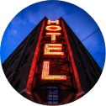
Hotel - transport - currency
Lasting bonds and meaningful connections require time
and effort. Here’s what you should keep an eye on:
01.Hotels
02. Transportation
Participants are responsible for booking their own hotel rooms. A list of selected hotels, which will be served by scheduled transport, is available. For all reservations, please send a copy to the following e-mail address: mamadou.gueye@artp.sn
ARTP will provide transport for participants between the airport and their respective hotels, as well as between the hotels and the meeting venue. To this end, participants are requested to submit their hotel reservation and flight plan information on the form sent for this purpose by Wednesday, May 21, 2025.
03. Local currency
06. Change
The basic unit of currency is the CFA franc. Banknotes are issued in the following denominations: 500 FCFA, 1000 FCFA, 2000 FCFA, 5000 FCFA and 10000 FCFA
The main exchange rates are as follows.
U.S Dollar: 601.47 FCFA
Euro: 655.96 FCFA
British Pound: 783.15 FCFA
source: Daily interbank exchange rates
7

Slide 8
Banks- weather - electricity
05.Banks
06. Weather
Banks are open Monday to Friday from 08:30 (UTC) to 15:30 (UTC).
Commercial banks offer foreign exchange facilities
Average weather from May 21 to 31 Below you will find general information about the weather in Dakar for the month of May:
Weather at 9am 24°C
Weather at 12pm 26°C
Weather at 6pm 25°C
07. Local Time
08. Electricity
The local voltage is 230 V, at a frequency of 50 Hz, with plugs of the following types:
Type C: two parallel round pins.
Type D: three round pins.
Type E: two parallel round pins and a hole above.
Local time is Greenwich Mean Time (GMT), which corresponds to the same time zone as Universal Time (UTC).
8

Slide 9
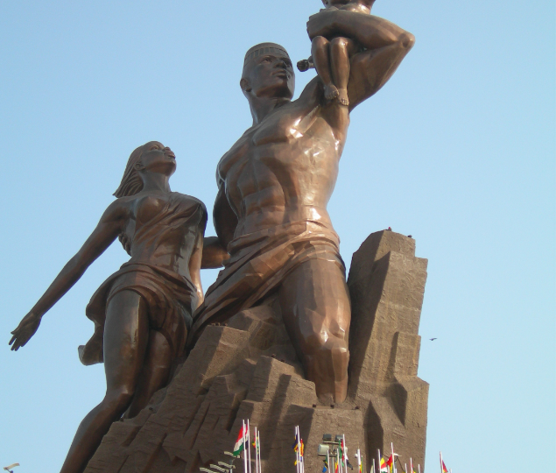
26th Ordinary Session of the ATU Board of Directors
-Dakar
REGISTRATION
REGISTRATION LINK
https://tally.so/r/3x6p9y
For any assistance, please contact Mr Kevin NDONG
kevin.ndong@artp.sn
Phone : 00221774500980
Only participants who have formally completed their registration form will be issued with a pre-confectioned badge. However, registration will be open at the King Fahd Palace Hotel from May 28 to 30, 2025.
9

Slide 10
LIST OF HOTELS
Hotels with special rates
Nearby hotels
5 *****
Hôtel KING FAHD PALACE
140.000 f CFA (roomsup.) /night
250.000 F CFA (suite junior) /night
3 stars
Hôtel LE LODGE Almadies
60.000 F CFA / night
Tel : 221 33 869 03 45
Distance : 1,1 km
4 *****
Hôtel AZALAI
133 666 F CFA/ night
Tel : 221 33 923 23 00
Distance : 12km
5 *****
Hôtel NOOM Ex Radisson BLU
198 000 FCFA / night
Tel : 221 33 869 33 33
Distance : 9,4 km
4 *****
Hôtel L’ADRESSE DAKAR
89.000 F CFA / night
Tel : 221 33 827 17 17
Distance : 1 km
4 *****
BOMA LIFESTYLE HOTEL
127 440 F CFA/ night
Tel : 221 33 859 02 50
Distance ; 4,3 km
3 stars
YAAS Hotel Dakar Almadies
66.000 F CFA / night
Tel : 221 33 859 07 00
Distance : 450 m
3 *****
Hôtel ONOMO DAKAR
158 100 F CFA/ night
Tel : 221 33 869 06 10
Distance : 9,3 km
3 *****
Hôtel FLEUR DE LYS (ALMADIES)
standard room : 77000 FCFA/night
Superior room: 95000 FCFA/night
Junior suite : 135000 FCFA/night
Premium suite: 175000 FCFA/night
Distance : 1,2 km
3 *****
HOTEL CASINO DU CAP-VERT
75 150 F CFA/ night
Tel : 221 33 869 78 78
Distance : 3,6 km
3 *****
Hotel COLONIA
65 650 F CFA/ night
Tel : 221 33 820 40 40
Distance : 4 km
5 *****
Hôtel TERROU-BI
189 900 F CFA/ night
Tel : 22133 839 90 39
Distance : 12 km
If you have any queries, please contact:
Mrs Kadjo DIOP kadjo.diop@artp.sn 00221775298154
Mrs Mariama NDAO mariama.ndao@artp.sn 002214501237
Mr Daouda DIOUF daouda.diouf@artp.sn 00221773339630
10

